Slide 1

eats by YOU
Presented by IEEE@UCF

Slide 2
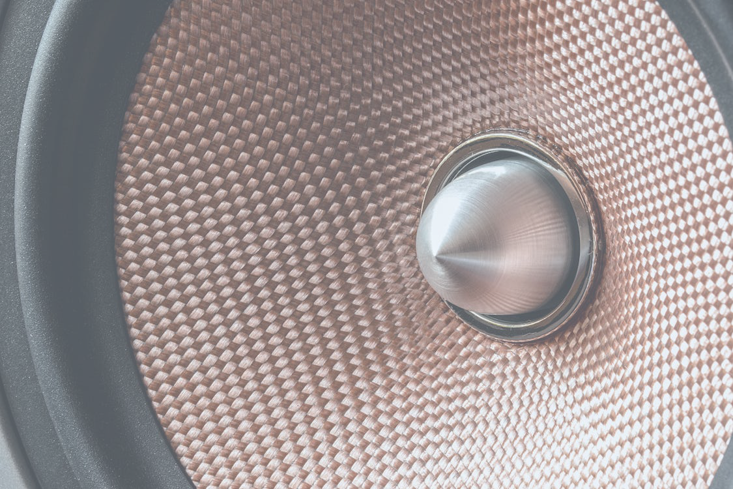

What is sound?
Notes:
“Who here has heard about sound waves ? What can you tell me about them” All we need to know is that soundwaves have frequency and amplitude

Slide 3

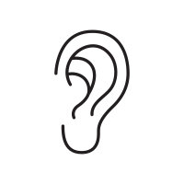

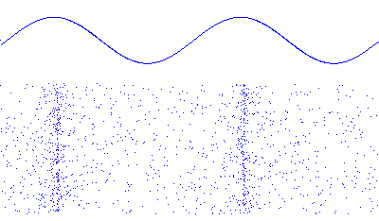
What is a speaker ?
Notes:
So what is a speaker ? We have some digital, electronic input

Slide 4
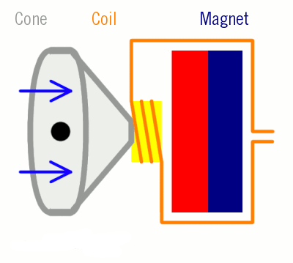
How does a speaker work ?
Notes:
A speaker uses electricity and magnets to push and pull a cone at the same frequency of that electric signal. But how does it do this ? (next slide)

Slide 5
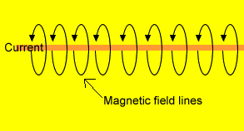
How is the coil moved?
Electromagnetics !!!
Notes:
Electricity and magnetism are proportionally related

Slide 6
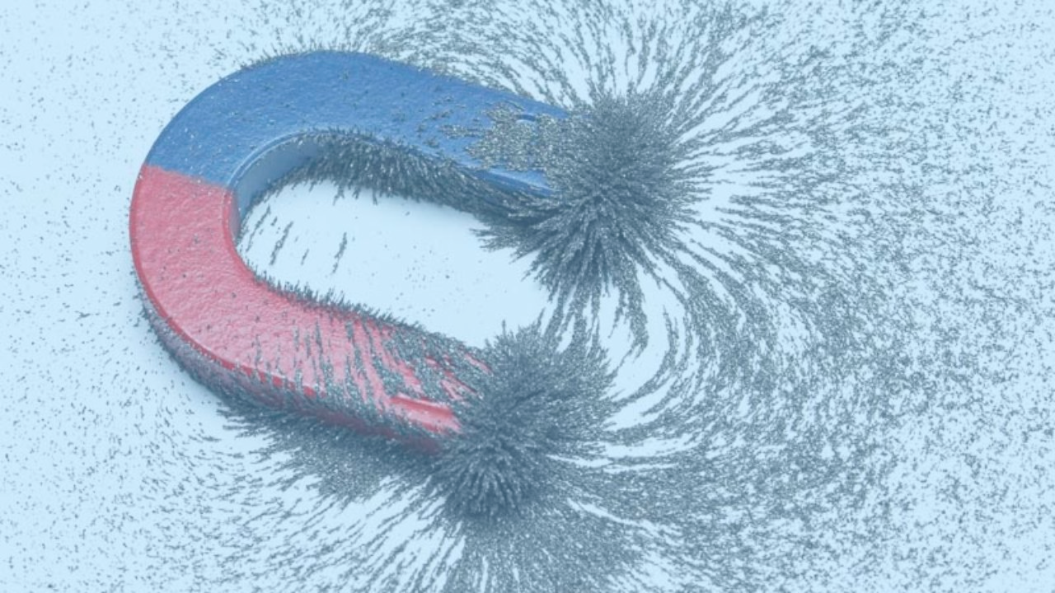
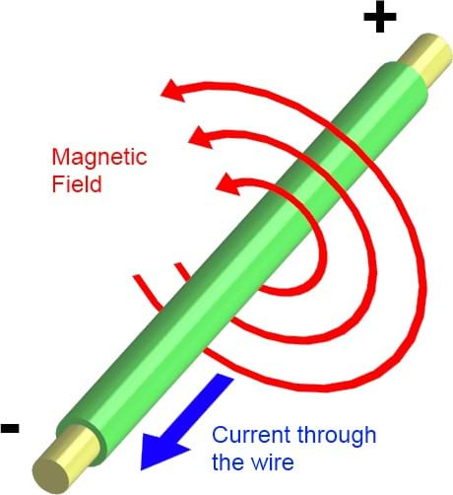
What is Electromagnetics ?
Any flow of electricity ALWAYS produces a correlating magnetic field

Slide 7
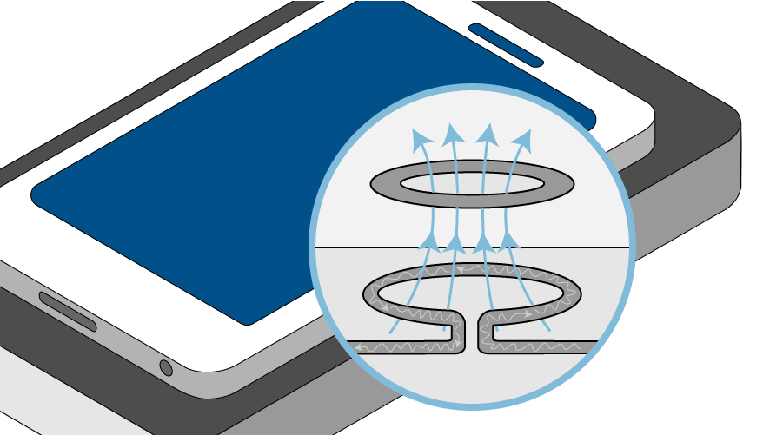
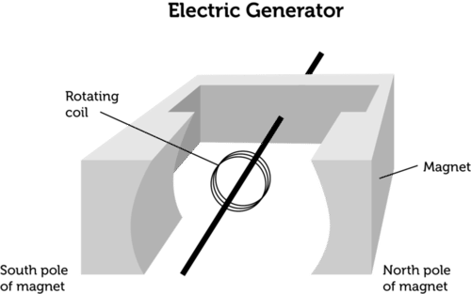
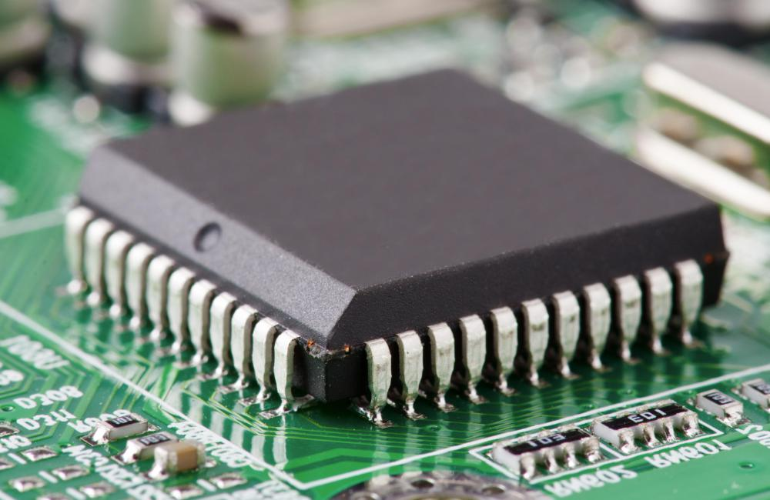

Slide 8
How can we control this magnetic field?

Slide 9
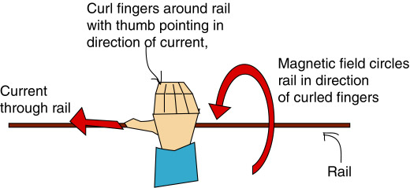
The right hand rule

Slide 10
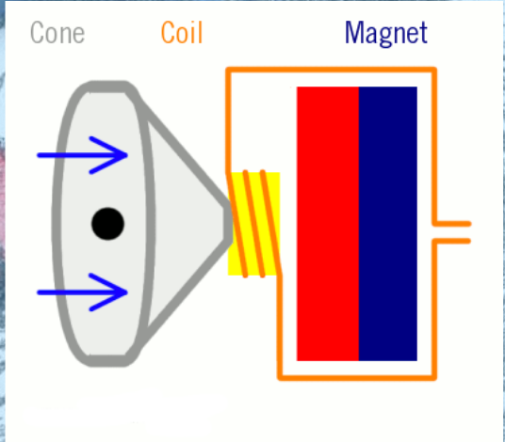
The right hand rule

Slide 11
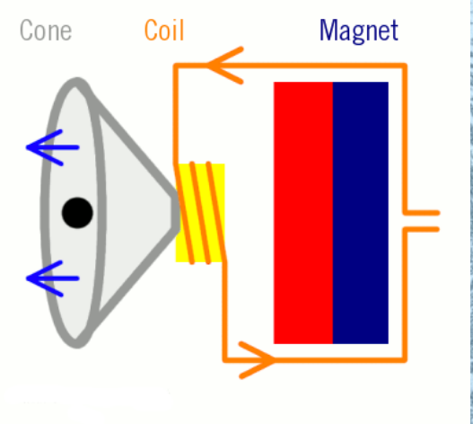
The right hand rule

Slide 12
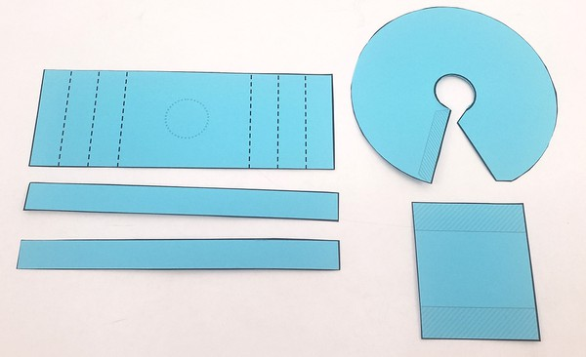
Step 1 : Cut

Slide 13
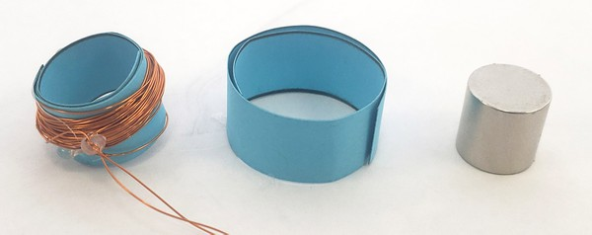
First steps :

Slide 14
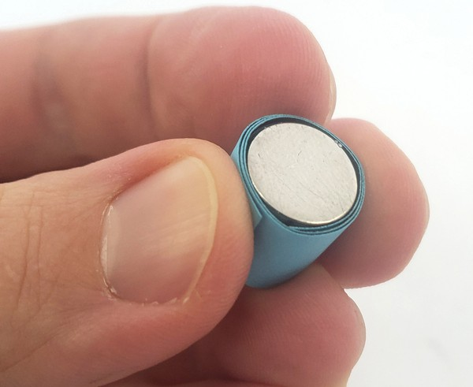
Step 2
Wrap 1st strip around magnets

Slide 15
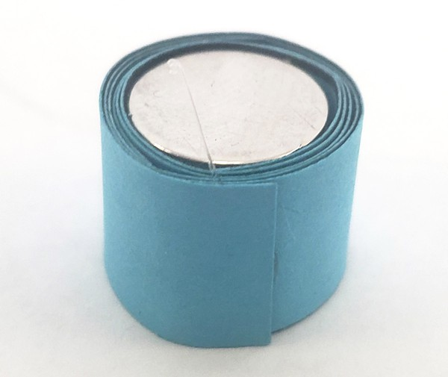
Step 3
Wrap 2nd strip and glue

Slide 16
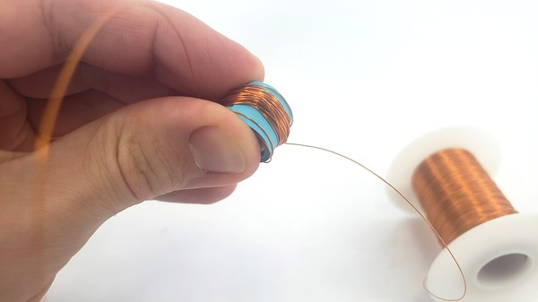
Step 4
Wrap wire 50+ times around coil

Slide 17
Step 4
Wrap wire 50+ times around coil

Slide 18
Recap

Slide 19
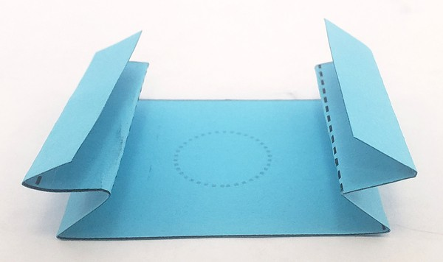
Step 5
Fold “accordion style”

Slide 20
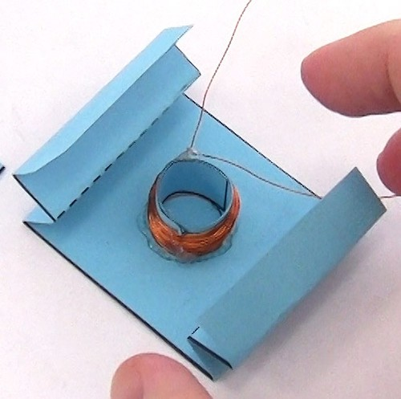
Step 6
Glue Coil in center

Slide 21
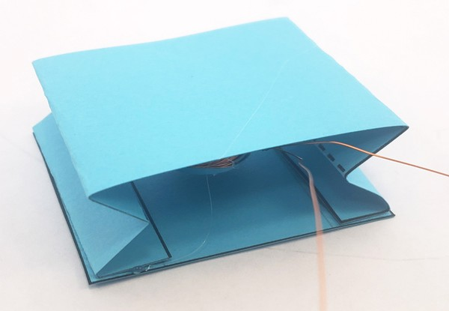
Step 7
Glue bottom on

Slide 22
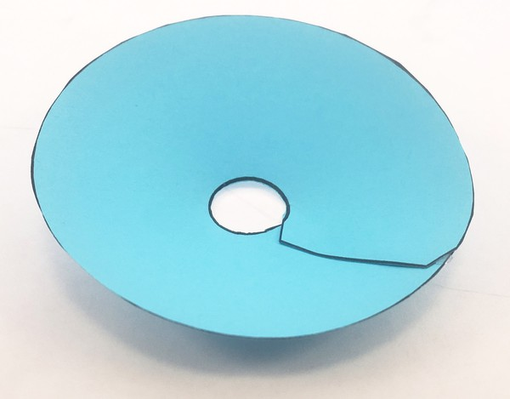
Step 8
Assemble Cone

Slide 23
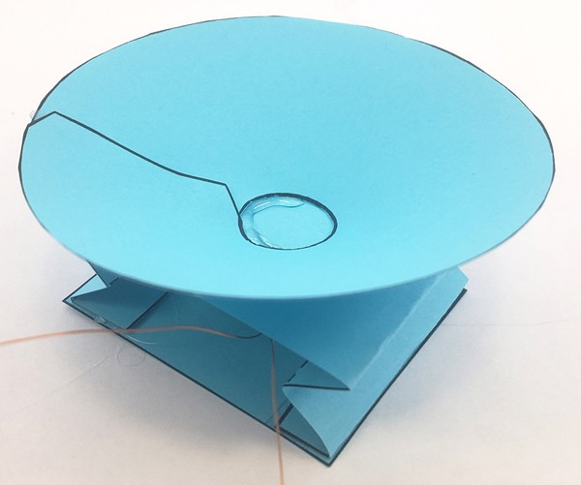
Step 9
Attach Cone

Slide 24
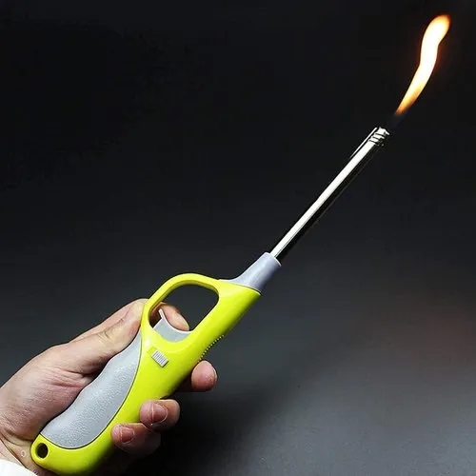
Step 10
De-Enamel the wire (Raise your hand)

Slide 25
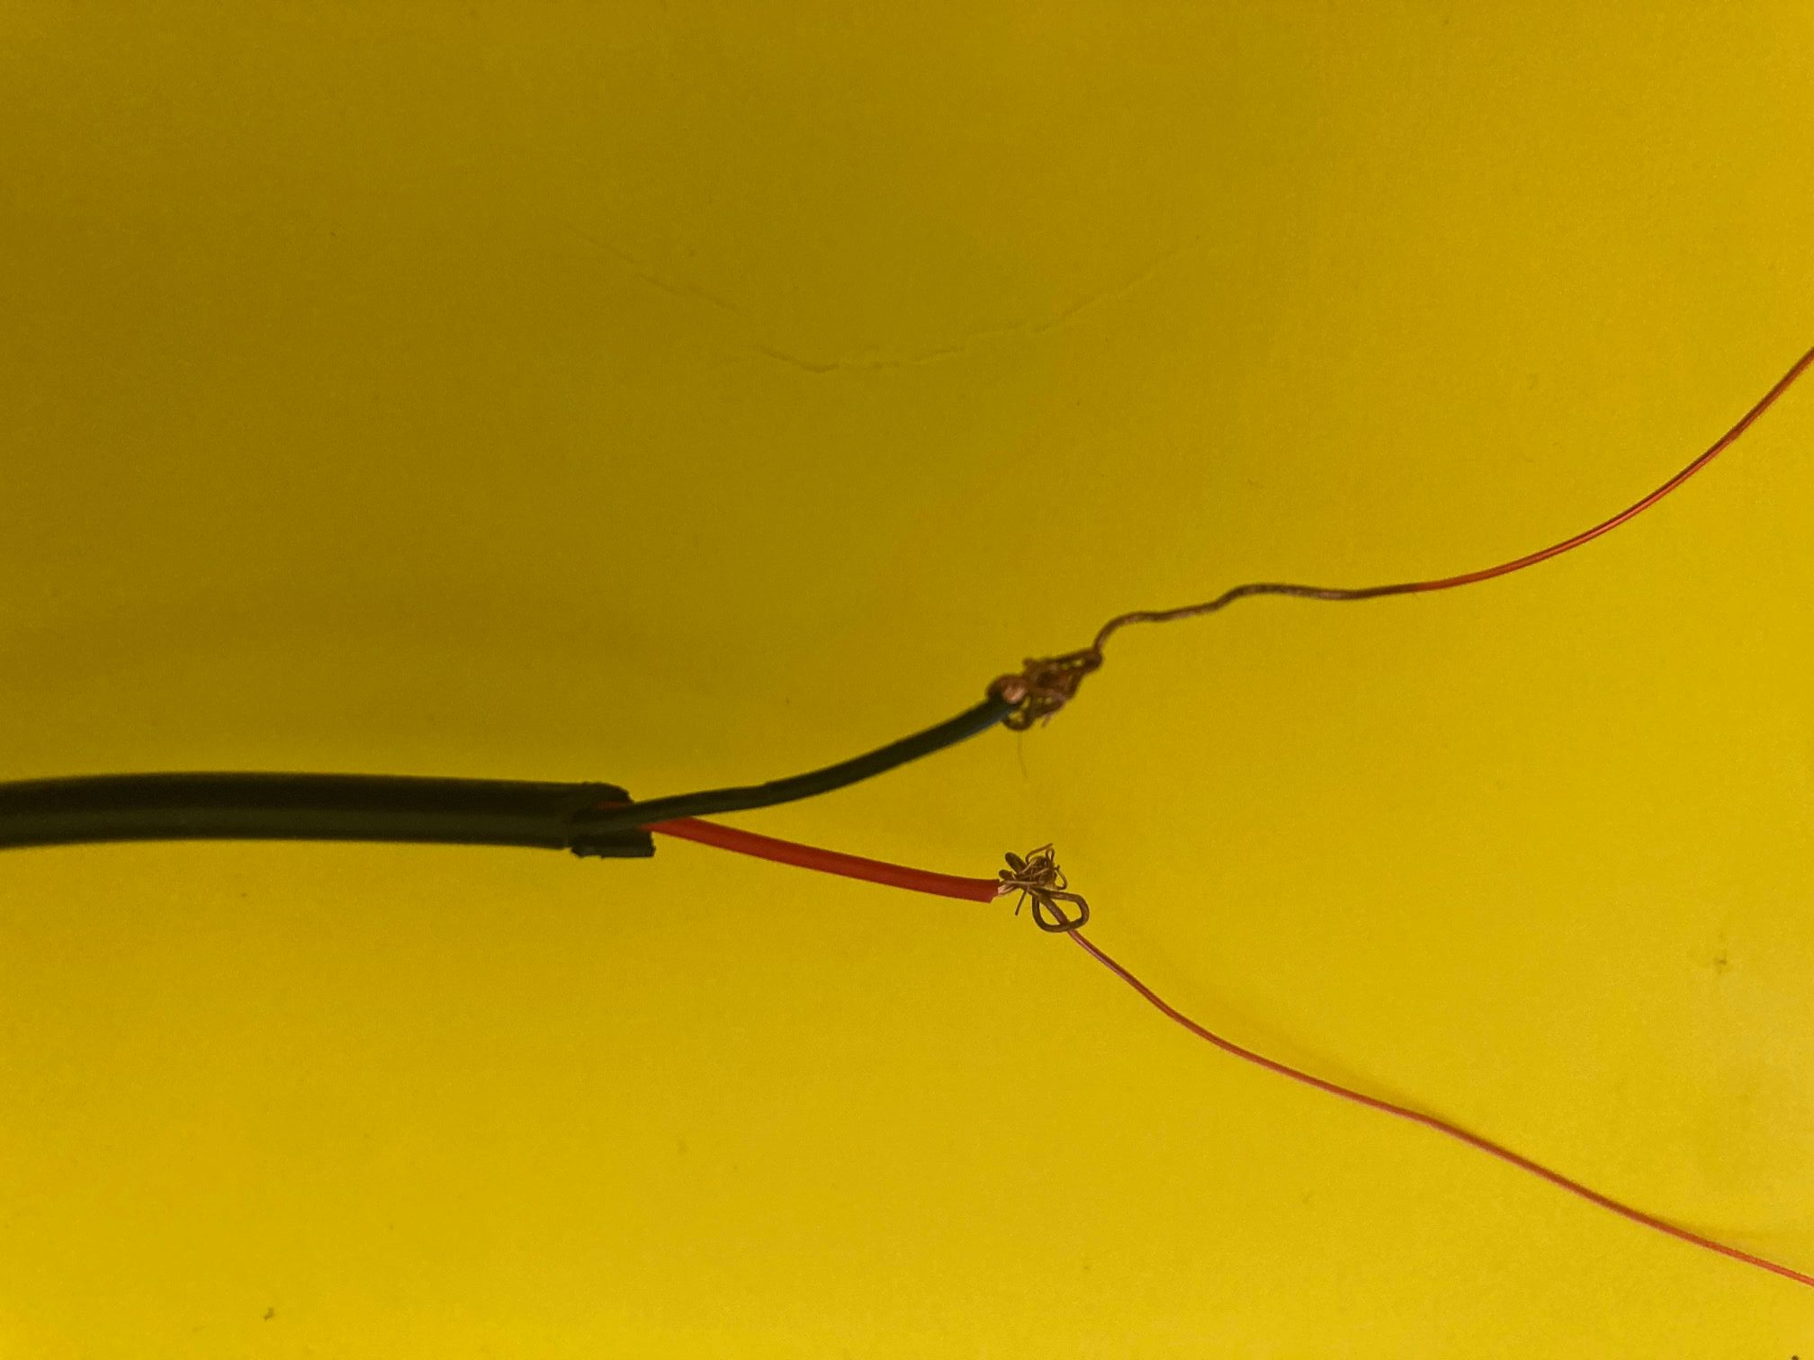
Step 11
Tape the wires together (Order does not matter)

Slide 26


Slide 27
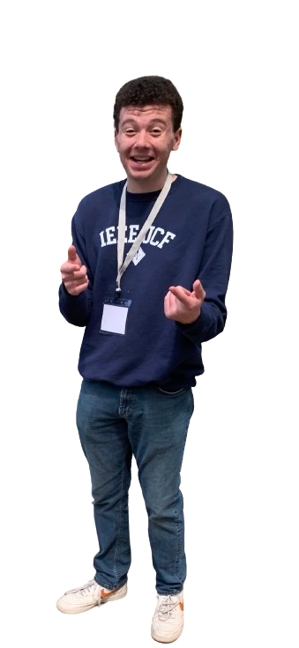
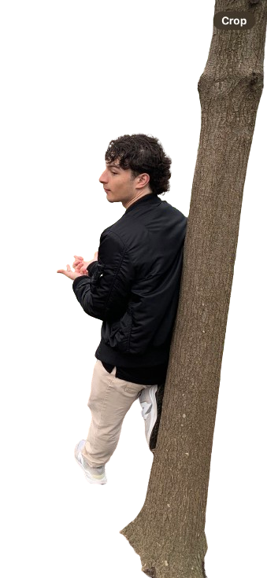

Thank You!

